Slide 1
UNIT 3 Serial Port Programming
Asst. Prof Ravi U. Kalkundri

Slide 2
The 8051 has two timers/counters, they can be used either as
Timers to generate a time delay or as
Event counters to count events happening outside the microcontroller.
Both Timer 0 and Timer 1 are 16 bits wide
Since 8051 has an 8-bit architecture, each 16-bits timer is accessed as two separate registers of low byte and high byte

Slide 3
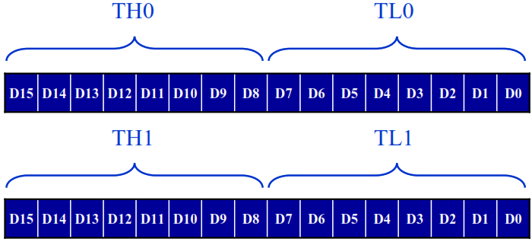
Accessed as low byte and high byte
The low byte register is called TL0/TL1, and
The high byte register is called TH0/TH1
Accessed like any other register
MOV TL0, #4FH
MOV R5, TH0

Slide 4
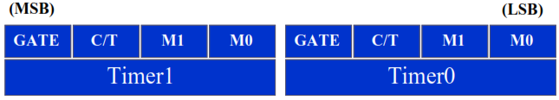
Both timers 0 and 1 use the same register, called TMOD (timer mode), to set the various timer operation modes.
TMOD is a 8-bit register
The lower 4 bits are for Timer 0
The upper 4 bits are for Timer 1
In each case,
The lower 2 bits are used to set the timer mode
The upper 2 bits to specify the operation

Slide 5
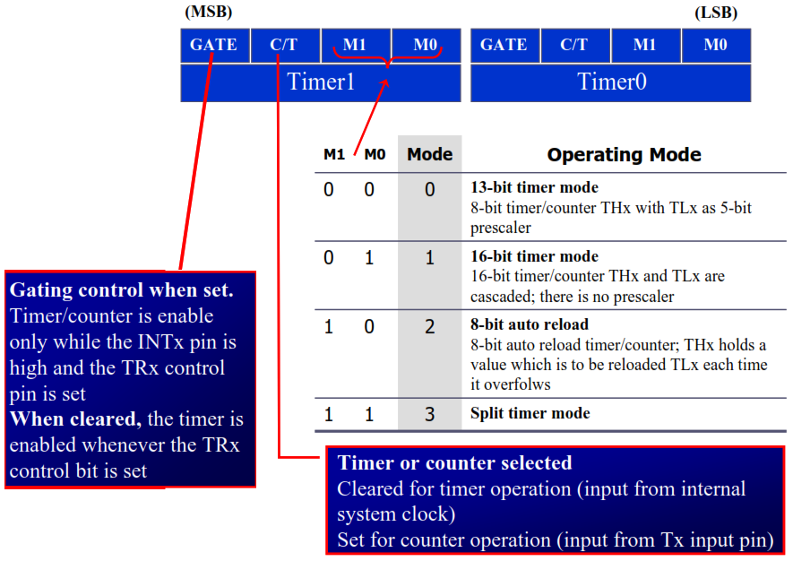

Slide 6
Example 9-1
Indicate which mode and which timer are selected for each of thefollowing.
MOV TMOD, #01H (b) MOV TMOD, #20H (c) MOV TMOD, #12H
Solution:
We convert the value from hex to binary.
(a) TMOD = 00000001, mode 1 of timer 0 is selected.
(b) TMOD = 00100000, mode 2 of timer 1 is selected.
(c) TMOD = 00010010, mode 2 of timer 0, and mode 1 of timer 1 are
selected.

Slide 7
Serial Port Programmng in C (continue..)
Example 10-16: Write a program for the 8051 to transfer “YES”serially at 9600 baud, 8-bit data, 1 stop bit, do this continuously
Solution:
#include<reg51.h>
void SerTx(unsigned char);
void main(void)
{
TMOD,#20H; //timer 1,mode 2(auto reload)
TH1,#-3; //9600 baud rate
SCON,#50H; //8-bit, 1 stop, REN enabled
TR1=1; //start timer 1
while(1)
{
SerTx(‘Y’);
SerTx(‘E’);
SerTx(‘S’);
}
}
void SerTx(unsigned char x)
{
SBUF=x;
while(TI==0);
TI=0;
}

Slide 8
Serial Port Programmng in C (continue..)
Example 10-17: Program the 8051 in C to receive bytes of data serially and put them in P1. Set the baud rate at 4800, 8-bit data, and 1 stop bit.
Solution:
#include <reg51.h>
void main(void){
unsigned char mybyte;
TMOD=0x20; //use Timer 1, mode 2
TH1=0xFA;` //4800 baud rate
SCON=0x50;
TR1=1; //start timer
while (1)
{ //repeat forever
while (RI==0); //wait to receive
mybyte=SBUF; //save value
P1=mybyte; //write value to port
RI=0;
}
}

Slide 9
The steps that 8051 goes through in transmitting a character via TxD
The byte character to be transmitted is written into the SBUF register
The start bit is transferred
The 8-bit character is transferred on bit at a time
The stop bit is transferred
It is during the transfer of the stop bit that 8051 raises the TI flag, indicating that the last character was transmitted
By monitoring the TI flag, we make sure that we are not overloading the SBUF.
If we write another byte into the SBUF before TI is raised, the untransmitted portion of the previous byte will be lost
After SBUF is loaded with a new byte, the TI flag bit must be forced to 0 by CLR TI in order for this new byte to be transferred

Slide 10
LCD Interfacing

Slide 11
LCD Interfacing
LCD is very commonly used electronic display module and having a wide range of applications such as calculators, laptops, mobile phones etc.
16×2 character is very basic module which is commonly used in electronics devices and projects.
It can display 2 lines of 16 characters.
Each character is displayed using 5×7 or 5×10 pixel matrix.
LCD can be interfaced with microcontroller in 4 Bit or 8 Bit mode.
These differs in how data is sent to LCD.
In 8 bit mode to write a character, 8 bit ASCII data is sent through the data lines D0 – D7 and data strobe is given through EN of the LCD.
LCD commands which are also 8 bit are written to LCD in similar way.

Slide 12
LCD Interfacing
4 Bit Mode uses only 4 data lines D4 – D7.
In this mode 8 bit character ASCII data and command data are divided into two parts and send sequentially through data lines.
The idea of 4 bit communication is used save pins of microcontroller.
4 bit communication is a bit slower than 8 bit communication but this speed difference can be neglected since LCDs are slow speed devices.
Thus 4 bit mode data transfer is most commonly used.

Slide 13
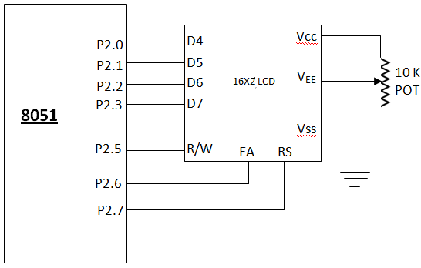
LCD Interfacing

Slide 14
LCD Interfacing
LCD Operations
LCD is finding widespread use replacing LEDs
The declining prices of LCD
The ability to display numbers, characters, and graphics
Incorporation of a refreshing controller into the LCD, thereby relieving the CPU of the task of refreshing the LCD
Ease of programming for characters and graphics

Slide 15
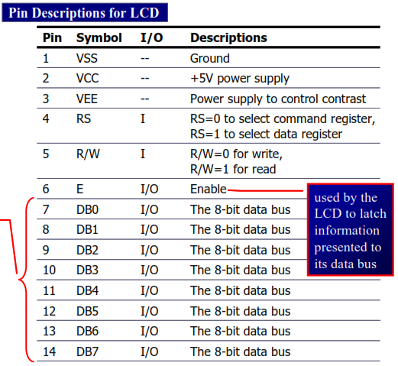
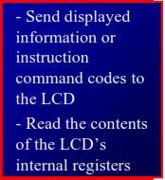
LCD Interfacing (continue..)

Slide 16
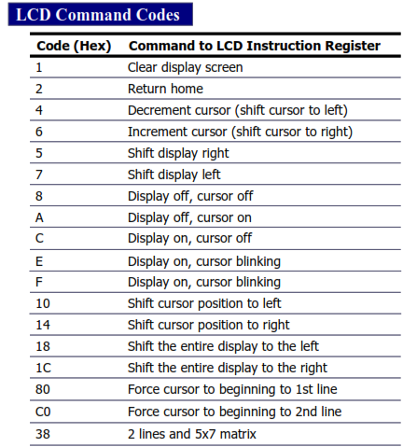
LCD Interfacing (continue..)

Slide 17
ADCs (analog-to-digital converters)

Slide 18
ADCs (analog-to-digital converters)
ADCs (analog-to-digital converters) are among the most widely used devices for data acquisition
A physical quantity, like temperature, pressure, humidity, and velocity, etc., is converted to electrical (voltage, current) signals using a device called a transducer, or sensor.
We need an analog-to-digital converter to translate the analog signals to digital numbers, so microcontroller can read them

Slide 19
ADCs (analog-to-digital converters)
ADC804 IC is an analog-to-digital converter
It works with +5 volts and has a resolution of 8 bits
Conversion time is another major factor in judging an ADC
Conversion time is defined as the time it takes the ADC to convert the analog input to a digital (binary) number.
In ADC804 conversion time varies depending on the clocking signals applied to CLK R and CLK IN pins, but it cannot be faster than 110 μs.

Slide 20
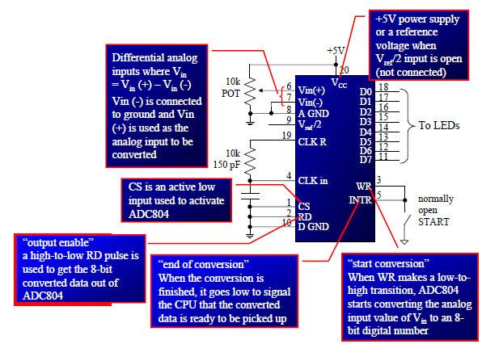
ADCs (analog-to-digital converters)

Slide 21
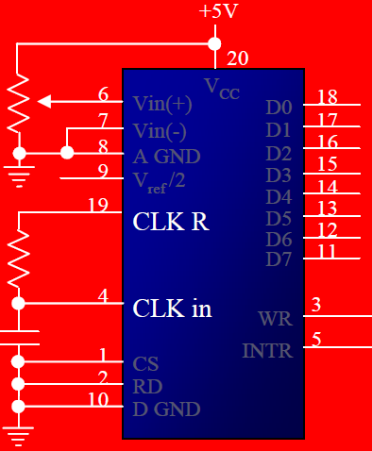
ADCs (analog-to-digital converters)
Block diagram of ADC

Slide 22

ADCs (analog-to-digital converters)
CLK IN and CLK R
CLK IN is an input pin connected to an external clock source
To use the internal clock generator (also called self-clocking), CLK IN and CLK R pins are connected to a capacitor and a resistor, and the clock frequency is determined by
Typical values are R = 10K ohms and C = 150 pF
We get f = 606 kHz and the conversion time is 110 μs

Slide 23
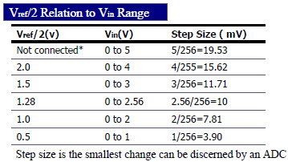
ADCs (analog-to-digital converters)
V_{ref}/2
It is used for the reference voltage
If this pin is open (not connected), the analoginput voltage is in the range of 0 to 5 volts (the same as the Vcc pin)
If the analog input range needs to be 0 to 4 volts, Vref/2 is connected to 2 volts

Slide 24

ADCs (analog-to-digital converters)
D0-D7
The digital data output pins
These are tri-state buffered
The converted data is accessed only when CS = 0 and RD is forced low
To calculate the output voltage, use the following formula
Dout = digital data output (in decimal),
Vin = analog voltage, and
step size (resolution) is the smallest change

Slide 25
ADCs (analog-to-digital converters)
Analog ground and digital ground
Analog ground is connected to the ground of the analog V_{in}.
Digital ground is connected to the ground of the V_{cc} pin
To isolate the analog V_{in} signal from transient voltages caused by digital switching of the output D0 – D7
This contributes to the accuracy of the digital data output

Slide 26
ADCs (analog-to-digital converters)
The following steps must be followed for data conversion by the ADC804 chip
Make CS = 0 and send a low-to-high pulse to pin WR to start conversion
Keep monitoring the INTR pin
If INTR is low, the conversion is finished
If the INTR is high, keep polling until it goes low
After the INTR has become low, we make CS = 0 and send a high-to-low pulse to the RD pin to get the data out of the ADC804

Slide 27
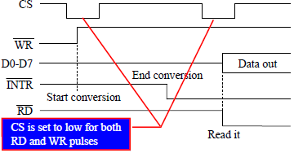
ADCs (analog-to-digital converters)

Slide 28
ADCs (analog-to-digital converters)
T1
T2
T3
T4
T5
T6

Slide 29
Sensors
This section will show how to interface sensors to the microcontrollor.
Examine some popular sensors.

Slide 30
Sensors
Temperature Sensor
Transducers convert physical data such as temperature, light intensity, flow and speed to electrical signals.
Depending on the transducer, the output produced is in the form of voltage, current or capacitance.
Eg: Temperature is converted to electrical signals using a transducer called Thermistor.

Slide 31
Sensors
LM34 temperature sensors
The sensors of the LM34 series are precision integrated- circuit temperature sensors, whose Voltage output is linear proportional to the Fahrenheit temperature.
Requires no external calibration, as it is internally calibrated.
Output- 10mV for each degree of Fahrenheit temperature

Slide 32
Sensors
LM34 temperature sensors
Table : LM34 Temperature Sensor Series Selection Guide
Part Scale | Temperature Range | Accuracy | Output
LM34A | -50 F to +300 F | +2.0 F | 10mV/F
LM34 | -50 F to +300 F | +3.0 F | 10mV/F
LM34CA | -40 F to +230 F | +2.0 F | 10mV/F
LM34C | -40 F to +230 F | +3.0 F | 10mV/F
LM34D | -32 F to +212 F | +4.0 F | 10mV/F

Slide 33
Sensors
LM35 temperature sensors
The sensors of the LM34 series are precision integrated- circuit temperature sensors, whose Voltage output is linear proportional to the Celsius (centigrade) temperature.
Requires no external calibration, as it is internally calibrated.
Its outputs 10mV for each degree of centigrade temperature.

Slide 34
Sensors
LM35 temperature sensors
Table : LM35 Temperature Sensor Series Selection Guide
Part | Temperature Range | Accuracy | Output
LM35A | -55 C to +150 C | + 1.0 C | 10mV/C
LM35 | -55 C to +150 C | + 1.5 C | 10mV/C
LM35CA | -40 C to +110 C | + 1.0 C | 10mV/C
LM35C | -40 C to +110 C | + 1.5 C | 10mV/C
LM35D | 0 C to +100 C | + 2.0 C | 10mV/C

Slide 35
Sensors
Signal conditioning and interfacing the LM35 to the 8051
Signal conditioning is widely used in the world of data acquisition.
The most common transducers produce an output in the form of voltage, current charge, capacitance and resistance.
We need to convert these signals to voltages in order to send input to an A-to-D convertor.
This conversion is commonly called Signal Conditioning.
Signal Conditioning can be a current-to-voltage conversion or a signal amplification.
Analog world (temperature, pressure, etc )
Transducer
Signal conditioning
ADC
Microcontroller

Slide 36
Sensors
//Program 13 – 2: C code to read temp from ADC0848, convert it to decimal, and put it on PO with some delay
#include <reg51.h>
sbit RD = P2^5;
sbit WR = P2^6;
sbit INTR = P2^7;
sfr MYDATA = P1; //P1 connected to DO-D7 of '848
void ConvertAndDisplay(unsigned char value) ;
void MSDelaylunsigned int value);
void main ()
{
MYDATA = OXFF; //make P1 and input
INTR =1; //make INTR and input
RD=1 // set RD high
WR=1; //set WR high
while(1)
{
WR=0; //send WR pulse
WR=1;
while(INTR = = 1); //wait for EOc
RD=0; //send RD pulse
value= MYDATA; // read vaue from ADCO848
ConvertAndDisplay (value);
RD=1;
}
}
void ConvertAndDisplay (unsigned char value)
{
unsigned char x, d1, d2,d3;
x=value/10;
d1=value%10;
d2=x%10;
d3=x/10;
P0=d1; //LSByte
MSDelay(250);
P0=d2;
MSDelay(250);
P0=d3; //MSByte
MSDelay(250);
}
void MSDelay(unsigned int value)
{
unsigned char x,y;
for(x=0;x<value;x++)
for(y=0;y<125;y++);
}

